Slide 1



FREELANCER EXPENSE TRACKER
NAME: BOOMADEVI S
ROLL NO: 23ITR016
DEPARTMENT: INFORMATION TECHNOLOGY
JAIHARI D (19ITR028)

Slide 2
Objectives
Track and manage income and expenses easily.
Provide a user-friendly, responsive web interface.
Enable secure login for personalized data.
Visualize financial data using dynamic pie charts.
Ensure a simple and scalable design for future improvements.
2

Slide 3

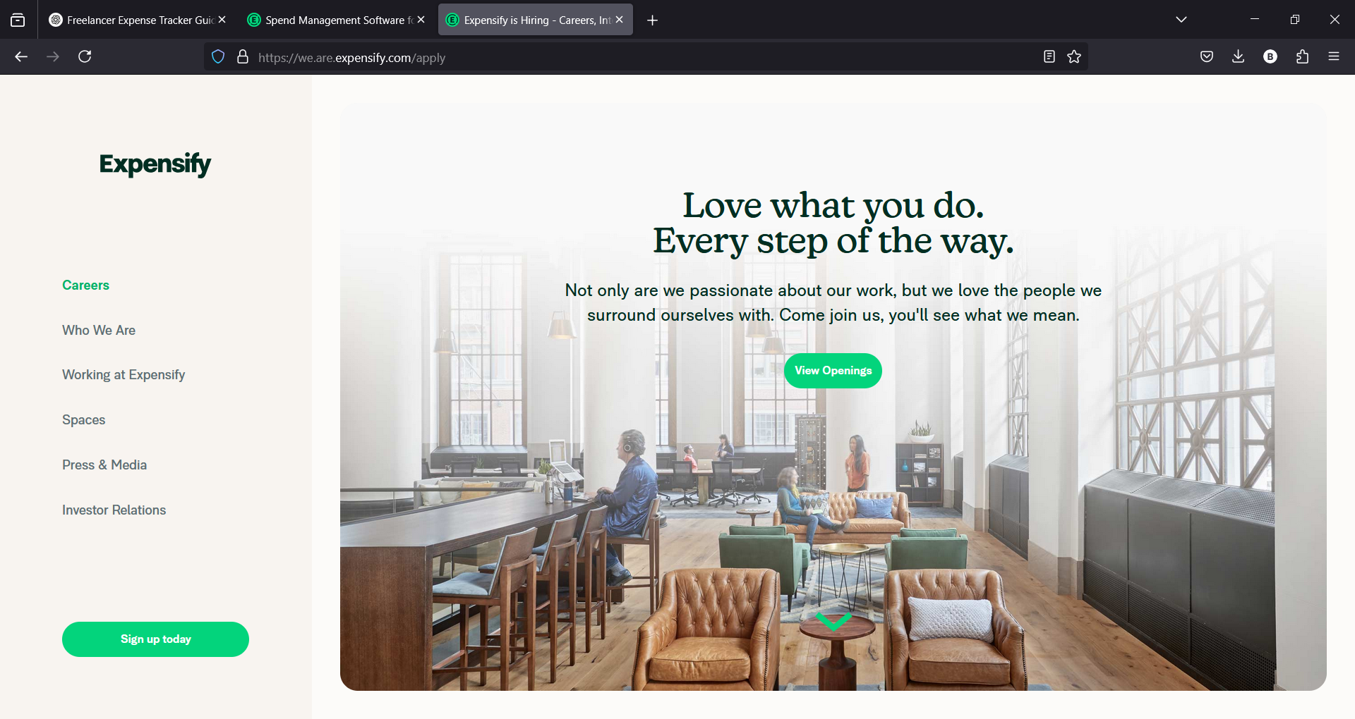
Existing System
Limited Free Plan.
Complex for Beginners
Dependence on Automation.
Limited Customization
Requires a subscription for full features

Slide 4
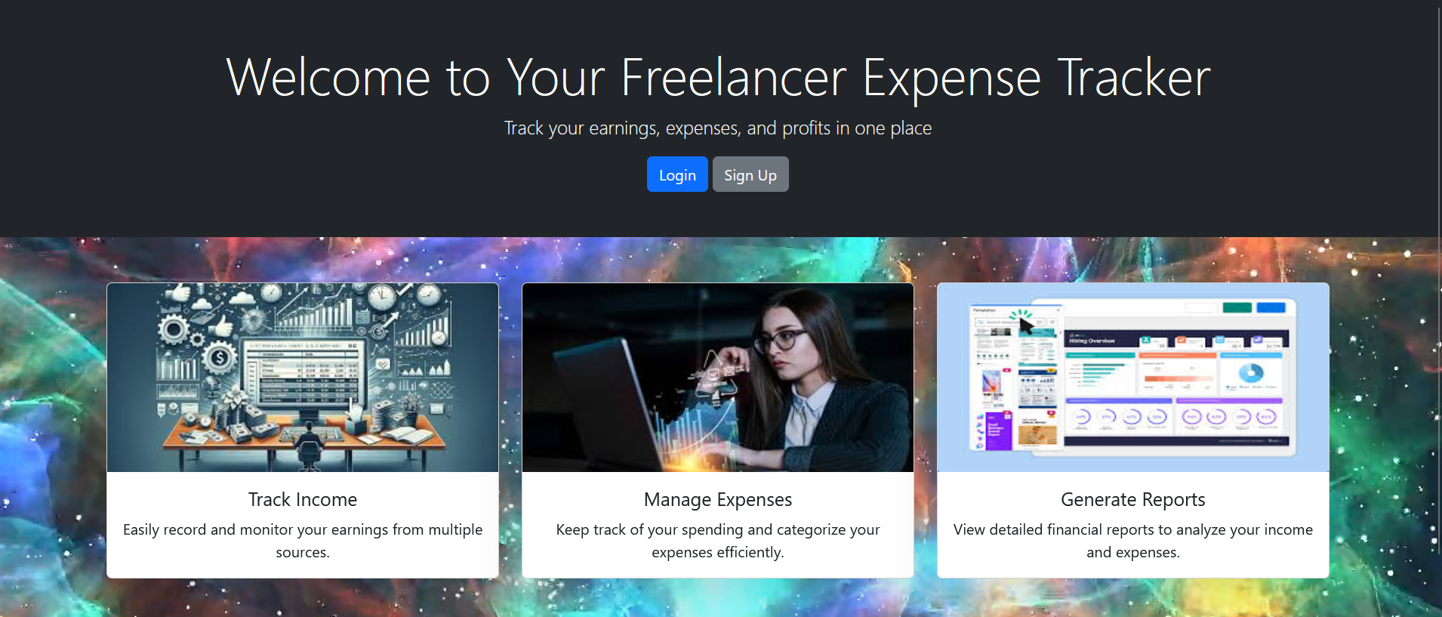
Proposed System
Completely Free – No subscription required.
Simple UI – Easy to use, even for beginners.
More Control – Users have full control over categorization.
No Dependence on Automation – Reduces incorrect categorization.
Customizable – Can be easily modified based on user needs.

Slide 5
Types Of Modules
Authentication Module:
[User/Admin Signup/Login] → [Role Check] → [Redirect to Dashboard]
User Dashboard Module:
[User Dashboard] → [Add Income/Expense] → [Logout]
Admin Dashboard Module:
[Admin Dashboard] → [View Users] → [CRUD]→ [Logout]
CRUD Operations for Income & Expense Data:
[Create] → [Read] → [Update] → [Delete] → [Store in MongoDB]

Slide 6
Module Description
1. Authentication Module
-Signup/Login: Users and admins sign up or log in.
- Role Check: After login, the system checks if the user is an admin or
regular user.
- Redirect to Dashboard: Redirects users to the User Dashboard or Admin Dashboard based on their role.
2. User Dashboard Module
- Dashboard: Users see their income and expense details.
- Add Income/Expense: Users can add income or expense records.
- Logout: Users can log out from the platform.

Slide 7
3. Admin Dashboard Module
- Dashboard: Admins can view all users and their data.
- View Users: Admins can see the list of all users.
- CRUD Operations: Admins can add, update, or delete user data.
- Logout: Admins can log out from the platform.
4. CRUD Operations for Income & Expense Data:
- Create: Users can add income or expense records.
- Read: Users and admins can view income/expense data.
- Update: Users can edit their records; admins can edit any user’s records.
- Delete: Users can delete their own records; admins can delete any user’s records.
- Store in MongoDB: All data is stored in MongoDB for persistence.

Slide 8
Tech Stack
Frontend:
HTML: Structure of the website.
Bootstrap: Ensures a responsive design.
JavaScript: Handles client-side logic.
Backend:
Node.js: Manages server-side logic.
MongoDB: Stores user data and transactions.
HTTP Module: Handles requests
Freelancer expense tracker
Front End
Back End
Html
Bootstrap
Javascript
Node.js
MongoDB
HTTP

Slide 9
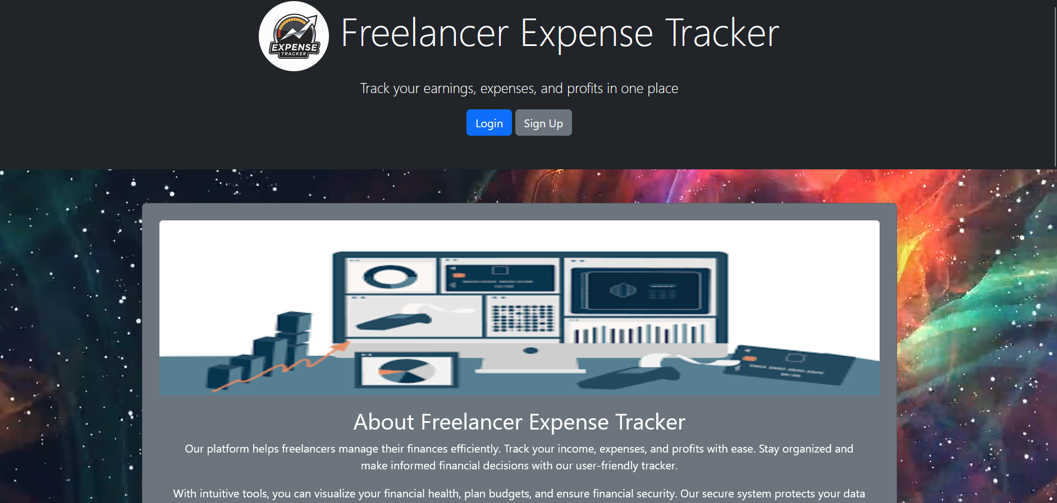

Screenshot
INDEX PAGE

Slide 10
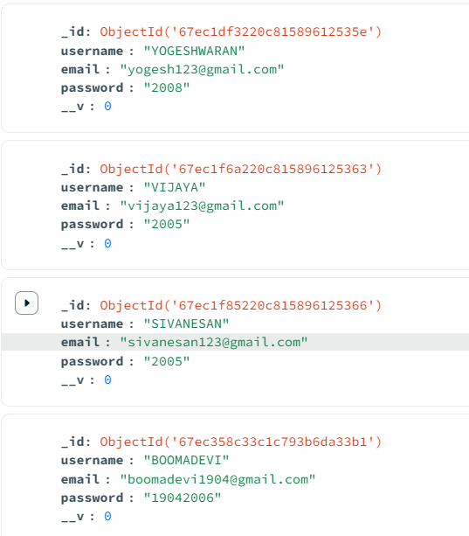
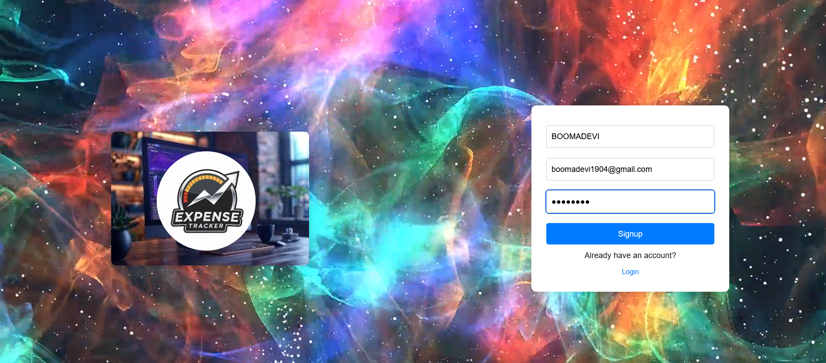
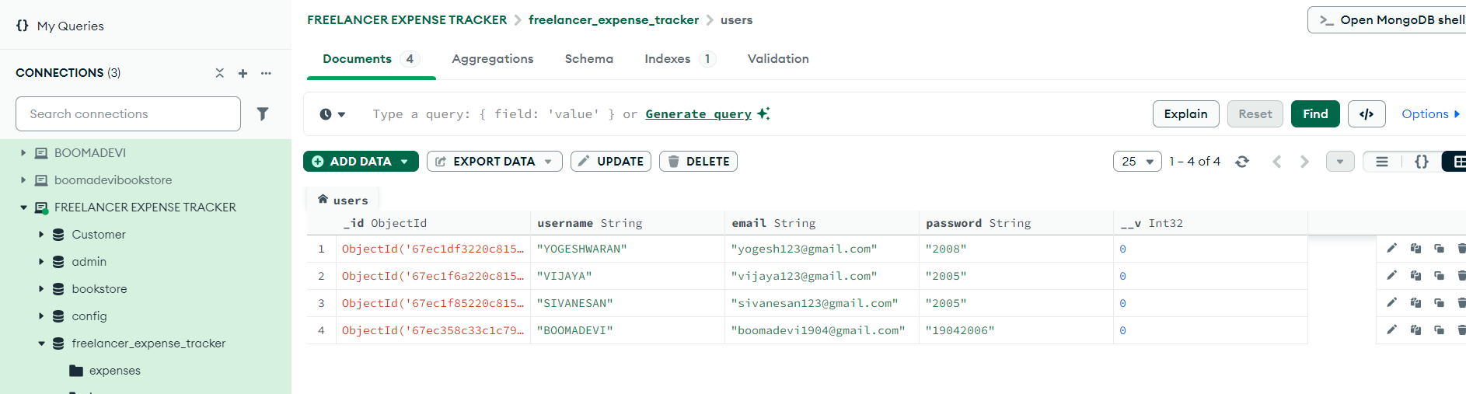
SIGNUP

Slide 11
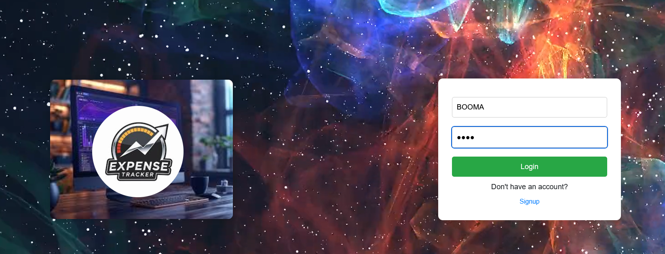
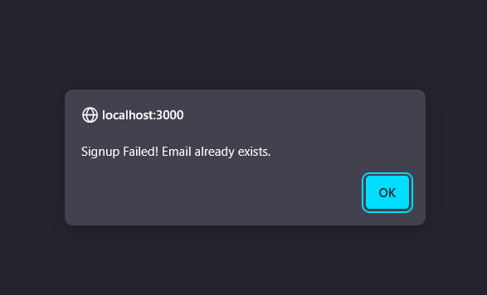
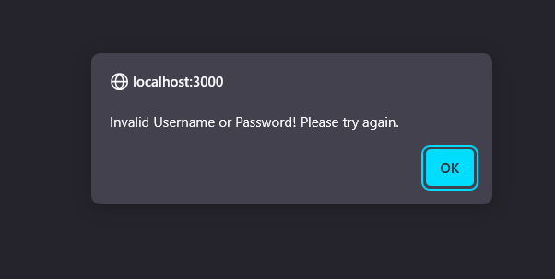
SIGNUP
LOGIN

Slide 12
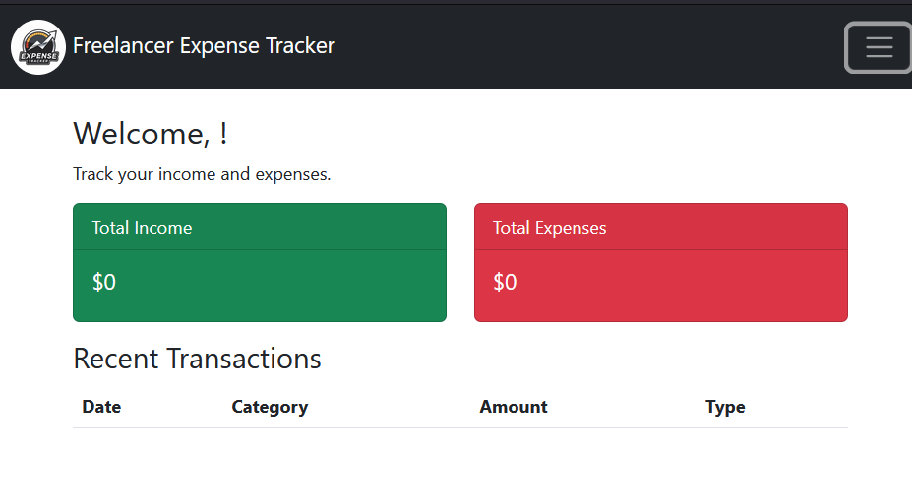
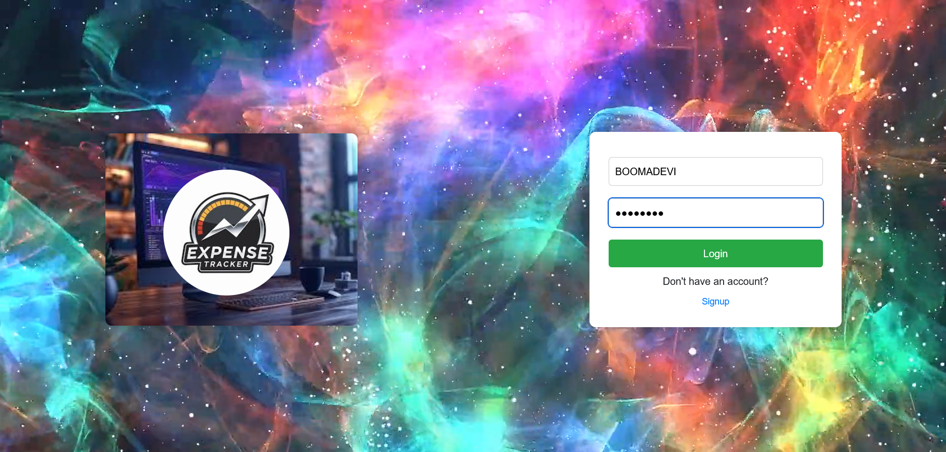
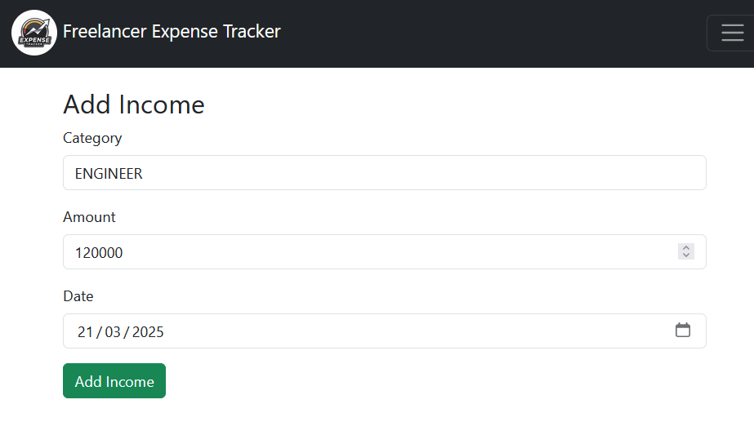
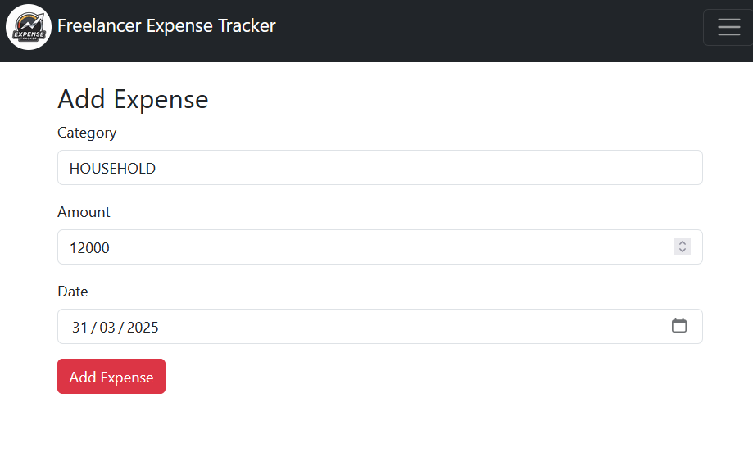
USER DASHBOARD

Slide 13
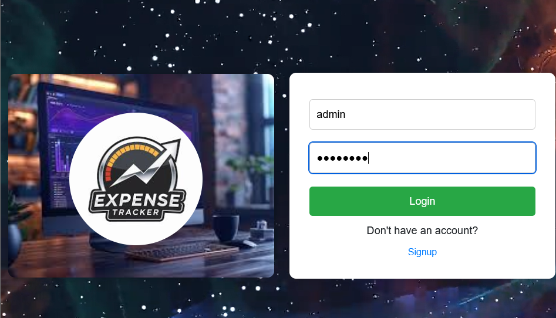
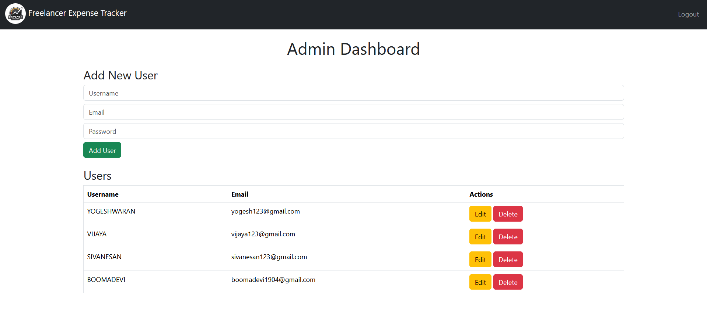
ADMIN DASHBOARD

Slide 14
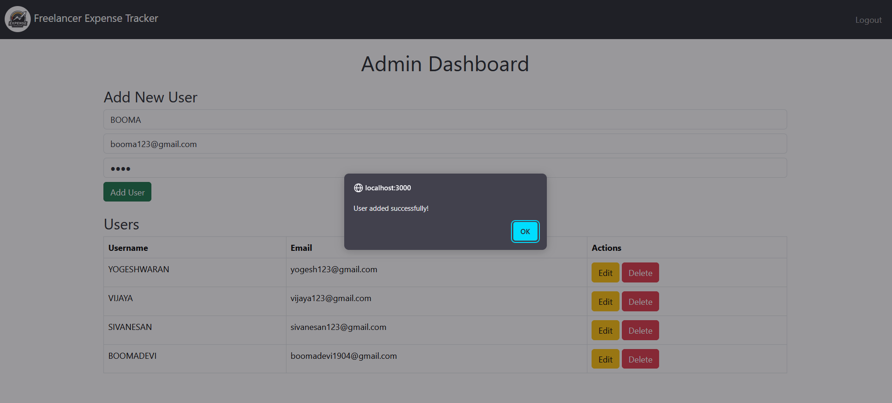
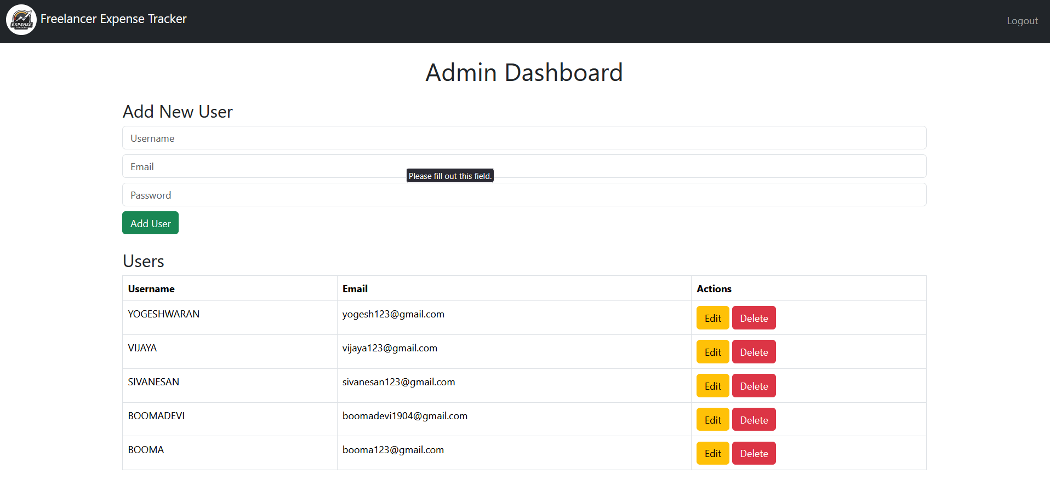
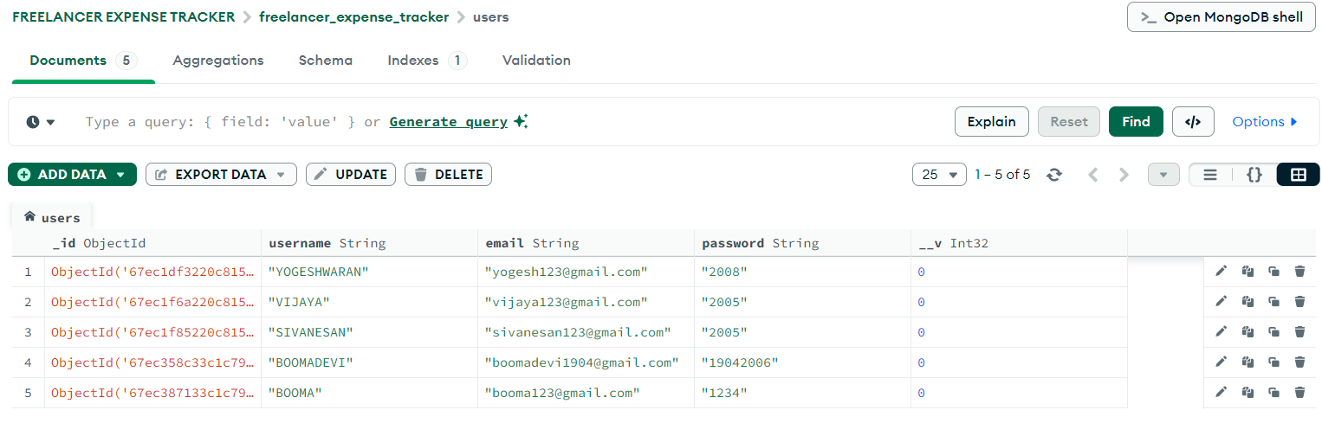
CRUD OPERATION

Slide 15
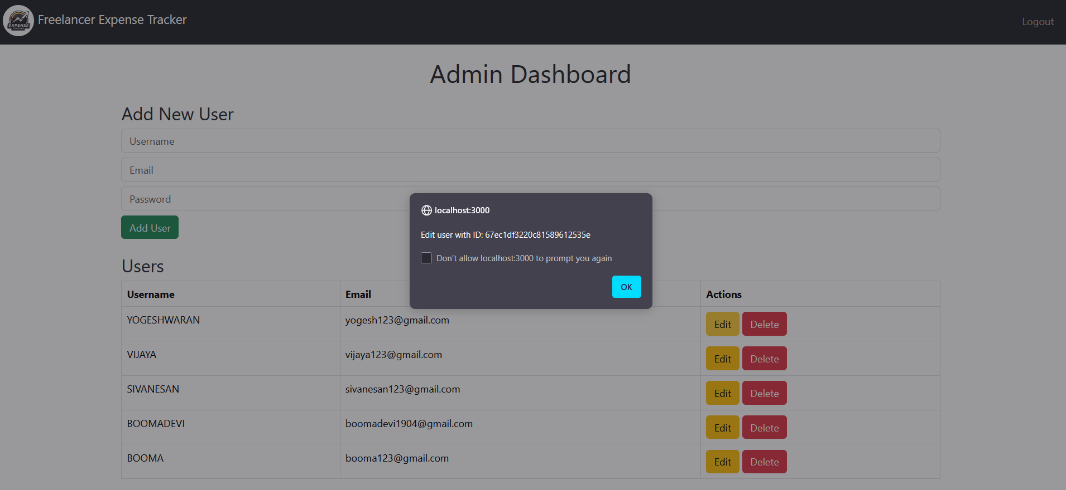
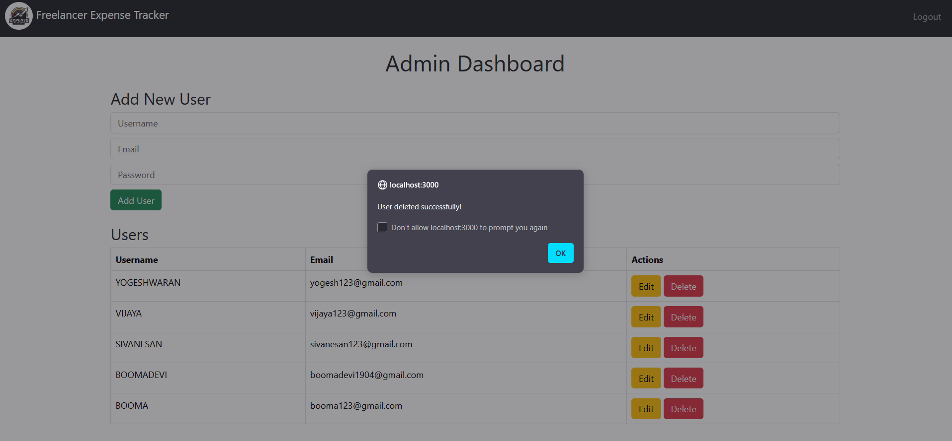
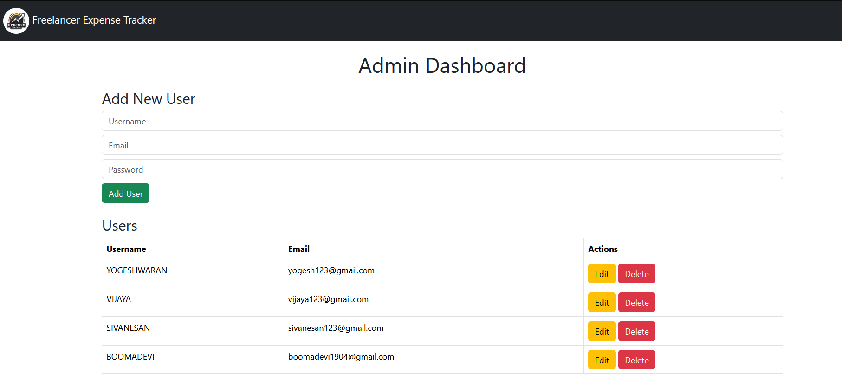
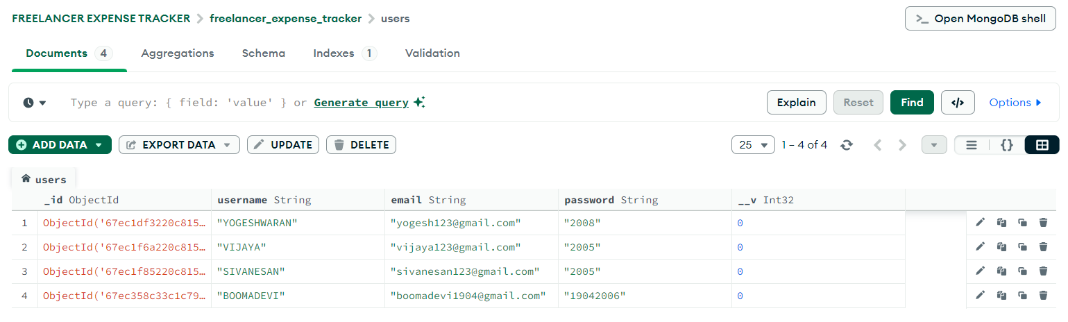

Slide 16
Reference
Website:
https://boomadevi-2006.github.io/FREELANCER-EXPENSE-TRACKER/
Code:
https://github.com/boomadevi-2006/FREELANCER-EXPENSE-TRACKER

Slide 17
THANK YOU!

